Slide 1
Data Structures
H16Y 35

Slide 2
Part B: Data Structures (Structured & Unstructured Data)

Slide 3
Unstructured/Simple Data
This represents the individual pieces of information contained in a data set e.g. Harry, 120.10 and 10.
Unstructured data are divided into the following categories:
Numeric: There are two main numeric data types: Integer and Real
Integers - Positive and negative whole numbers, i.e. numbers without a decimal point, e.g. 12, 0, -24.
Real or Floating Point - Numbers with fractional parts, i.e. with a decimal point, e.g. 12.4, -0.6, 3.149
Character: These data type can be thought of in terms of two sub-categories:
Single Characters: could represent a number, an alphabetic character, a punctuation mark, mathematical symbol, or a special symbol, e.g. '+', 'A' and '£‘
Strings.
Note: Characters and Strings are usually enclosed in quotation marks when used by a programming language.
Logical (Boolean): Data type characterised by variables that can only take values True and False

Slide 4
Unstructured/Simple Data – Contd.
Simple data types have the following characteristics:
A name or identifier by which it is referred to , e.g. Mark
A type which specifies the type of data which can be stored, e.g. Integer
A value which is assigned to it and if it is a variable may be changed, e.g. 50
* General Classification
Boolean
Character
Float
Integers

Slide 5
Structured Data
This applies to groups (or collections) of data items that are linked together (i.e. related) for some purpose.
Although simple data types are invaluable in programming there are situations when a programmer can be assisted by the ability to organise and structure data within programs.
Note:
The different ways of organising data is also referred to as ‘Data Structures’.
Examples of Structured Data
Arrays
Records
Tables (Hash Tables)
Files

Slide 6
Structured Data: Arrays
An array is a key method for structuring data, and its importance in programming is supported by it being a data structure that exists in all non-trivial programming languages.
An array refers to the collection of variables of similar class (type) and referred to as common name.
An array is a fixed-size collection of data items, all of the same type, grouped under the same name.
Note:
Each individual data item can be accessed by the use of an index value, called a subscript, which gives the position of the individual item in the structure.
Examples include:
Shopping list
Lottery numbers

Slide 7
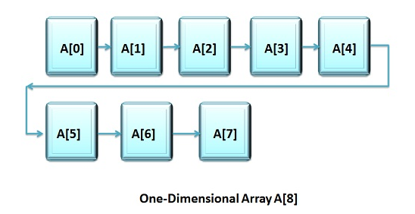
Structured Data: Arrays – Types
1 Dimensional (1D) Arrays:
One-Dimensional or Single-Dimensional array is considered as the” list of variables of similar data types”, and each variable can be distinctly accessed by specifying its index in square brackets preceded by the name of that array.

Slide 8
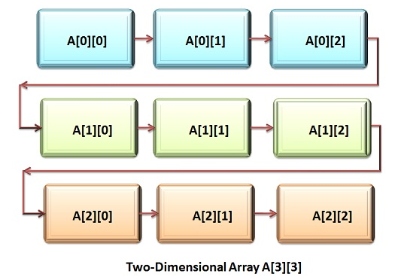
Structured Data: Arrays – Types
2 Dimensional (2D) Arrays:
A two-Dimensional array can be considered as ‘array of arrays’ or ‘array of one-dimensional arrays’.
To declare the two-dimensional array variable, we have to specify the array name followed by two square brackets where the second index is the second set of square brackets.
A two-dimensional array is stored in the form of the row-column matrix, where the first index indicate the row and second index indicates the column.

Slide 9
Structured Data: Arrays – Types
Example – 1D Arrays (Lottery Array)
The example above shows a one-dimensional array because there is only one direction associated with the structure.
Note: Each position in the array has an associated subscript value. These subscripts normally start at 1 although 0 is also a common starting point. Element 2 of the structure would be LotteryArray[2].
Example – 2D Arrays (EyeChartArray)
From the example above, In order to identify individual elements we now require a row number and a column number, e.g. EyeChartArray[1, 1] is the V character.
Subscript | 1 | 2 | 3 | 4 | 5 | 6
Value | 26 | 18 | 36 | 42 | 3 | 19
 | 1 | 2 | 3 | 4
1 | V | % | £ | D
2 | j | 4 | : | N
3 | j | T | E | P

Slide 10
Structured Data: Records
A record is a collection of data items which unlike an array need not necessarily be of the same data type.
Example: An employee record might have the following data items.
EmpNo - String
EmpName - String
DeptCode - Integer
Salary - Real
Real world Example - Police record or Employee record
A record contains all the information we know about a particular entity, e.g. all the information associated with a police suspect or an employee.
One of the fields (i.e. individual data items) is usually used to identify a particular record uniquely, e.g. employee number (EmpNo) from table below. This is known as the key field.
Note:
It is usually a good idea to specify exactly what the size of a string will be rather than leaving it as just string because the compiler may reserve 256 bytes for a default string.
EmpNo | EmpName | DeptCode | Salary
100 | Balstock | 001 | £30,000

Slide 11
Structured Data: Tables
A table describes a collection of records stored in main memory where each record must be of the same type, i.e. have the same number and type of fields.
Real world example: bus time table, flight times at the airports, etc…
A table is also known as an array of records. The table shown below is a table of Employee Records.
 | EmpNo | EmpName | DeptCode | Salary
1
2
3
4

Slide 12
Structured Data: Files
A file is a collection of data, usually records, stored on a backing storage device and therefore represents a more permanent collection of data unlike a table which resides in the main memory (RAM) and only exits while the program is running.
Real world example: A filing cabinet used to store Employee Records

Slide 13
Data Types - Programming
The concept of ‘Data Types’ applies to different fields/disciplines depends on what they (i.e. data types/classes) are used for.
In Computer Programing, the concept of Data type is simply a way of classifying various types of data used during programming such as integer, string etc.
It determines the values that can be used with the corresponding type of data and the type of operations that can be performed on the corresponding type of data.
Data Types Can Be Grouped Into:
Built-in Data Type
Derived Data Type
Simple Data Type

Slide 14
Built-in Data Type
Those data types for which a language has built-in support are known as Built-in Data types.
For example, most of computer programming languages provide the following data types listed below.
Examples of Built-in data types.
Integers
Boolean (true, false)
Floating (Decimal numbers)
Character and Strings

Slide 15
Derived Data Type
Those data types which are implementation independent as they can be implemented in one or other way are known as derived data types.
These data types are normally built by combination of primary or built-in data types and associated operations on them.
Examples of Derived Data Types:
List
Array*
Stack
Queue

Slide 16
Resources - Links
http://datastruct.hnd-computing.info/
https://www.tutorialspoint.com/csharp/csharp_data_types.htm

